Slide 1
Programming Fundamentals
Prepared by Guhan Ganesan M.E.,

Slide 2
Topics to be covered
Algorithm
Pseudocode
Flowchart
Examples

Slide 3
Algorithm
An algorithm is the series of steps that must be executed to solve a problem.
A program consists of the set of instructions that generates the desired output of the given input.
To make the program work properly the algorithm must be properly designed.
The design of the algorithm also ensures the effective utilization of the computing resources, for example, CPU time, RAM, etcetera.

Slide 4
Features of an Algorithm
As we know that an algorithm takes some inputs, execute some finite number of steps and gives an output. So, the certain step involved in the algorithm must be executable.
It must generate some result.
After a specific period, it must cease to run.

Slide 5
Definition of Flowchart
It is a flow diagram which illustrates a process or a detailed series of steps needed to produce a specific output.
A flow chart is comprised of the different symbols and control lines to connect those symbols.
Each symbol specifies distinct functions.
It is extremely useful in programming because it simplifies the complicated algorithm and converts it into the understandable pictorial representation.
With the help of the flowchart, the application designer can easily segregate the different components of the process.
It facilitates the analysation by providing the step-by-step process of the problem.

Slide 6
Construction of the Flow Chart
Lozenges/Rounded rectangle: Show the starting and ending point of the process.
Rectangle: Illustrates a processing step

Slide 7
Cont..
Diamond: Renders the decision point generally in the form of Yes/No or True/False.
Control flow lines: Describes the flow and control of the data
Parallelogram: Represents the Inputs given to the process or an Output generated by the process.

Slide 8
Key Differences Between Algorithm and Flowchart
An algorithm involves a combination of sequential steps to interpret the logic of the solution. In contrast, a flowchart is the pictorial illustration of the algorithm.
A flow chart is more understandable as compared to the algorithm.
The algorithm is written in a language that can be perceived by humans. On the other hand, the flowchart is made up using different shapes and symbols.
There are no stringent rules are implemented in the algorithms while the flowchart is abode by predefined rules.
Errors and bugs are easily detected in the algorithm as compared to the flow charts.
Flow charts are simple to create. On the contrary, the construction of the algorithm is complex.

Slide 9
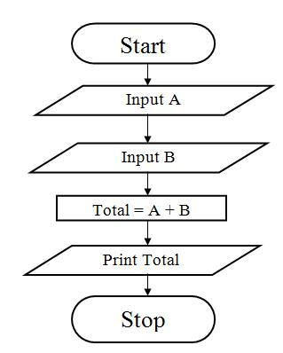
Example of flowchart
Flow chart for adding two numbers

Slide 10
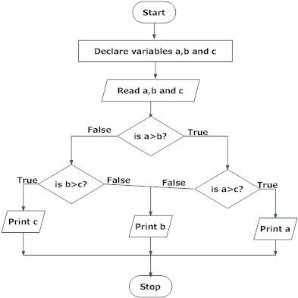
Cont..
Compare three numbers

Slide 11
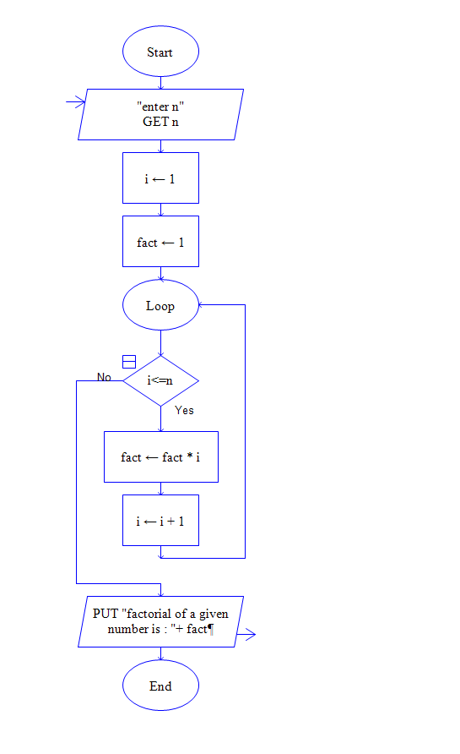
Flowchart for finding factorial

Slide 12
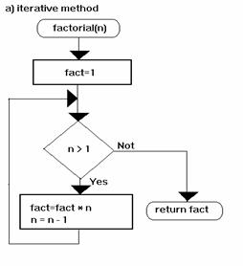
Flowchart of recursion

Slide 13
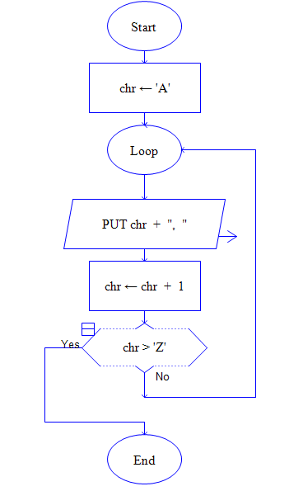
Flowchart for print A to Z

Slide 14
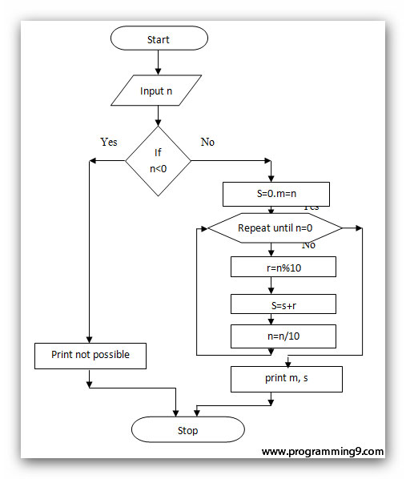
Sum of digits of a number

Slide 15
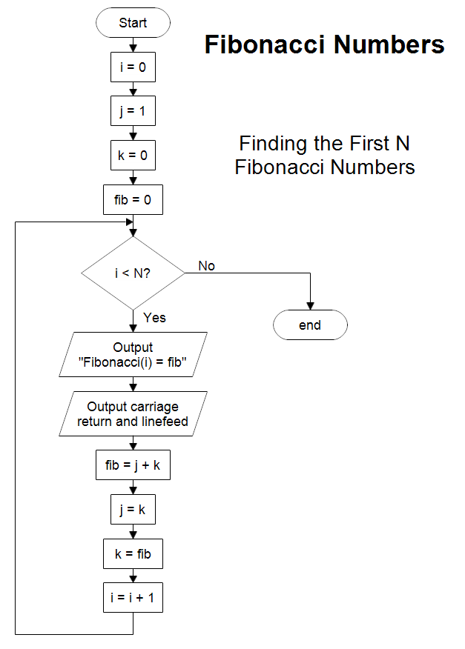

Slide 16
Pseducode
Pseudocode is the expressive form of the algorithm or a way to describe an algorithm.
It is a combination of natural language and high-level programming practices which represent the fundamental concept behind a general implementation of a data structure or algorithm.
Pseudocode incorporated the natural language when the details are insignificant with the standard programming language constructs to obtain more clarity.
However, we can not execute pseudocode on a computer, but it models the actual programming code along with a similar level of detail.

Slide 17
Specific words and characters of pseudocode
To begin the comment double forward slash are used “//“.
Matching braces “{ and }” are used to present blocks where a compound statement (set of simple statements) can be illustrated as a block and terminated by a semicolon”;“. The body of a procedure constructs a block as well.
All the identifiers start with a letter and the datatype of the variables are not declared explicitly.
An assignment statement is used for the assigning values to the variables.
To produce the boolean values (i.e., true and false) the logical operators and, or and not and the relational operators <, ≤, =, =, ≥ and > are provided. Input and output are presented by read and write instructions.
“if and then” expressions are used to express a conditional statement.

Slide 18
Differences Between Algorithm and Pseudocode
An algorithm is a definite, clear sequence-wise procedure to solve a problem.
It involves the high-level language builds which cannot be understood by a non-technical person.
On the other hand, pseudocode is a more plain and human understandable form of algorithm where natural language is also combined with the high-level programming language constructs.
Pseudocode is easy to understand and interpret as compared to an algorithm.
The algorithm uses high-level constructs meaning the snippet of code but the pseudocode involves natural language with high-level programming builds.
Pseudocode is easily constructed and debugged relative to the algorithm.

Slide 19
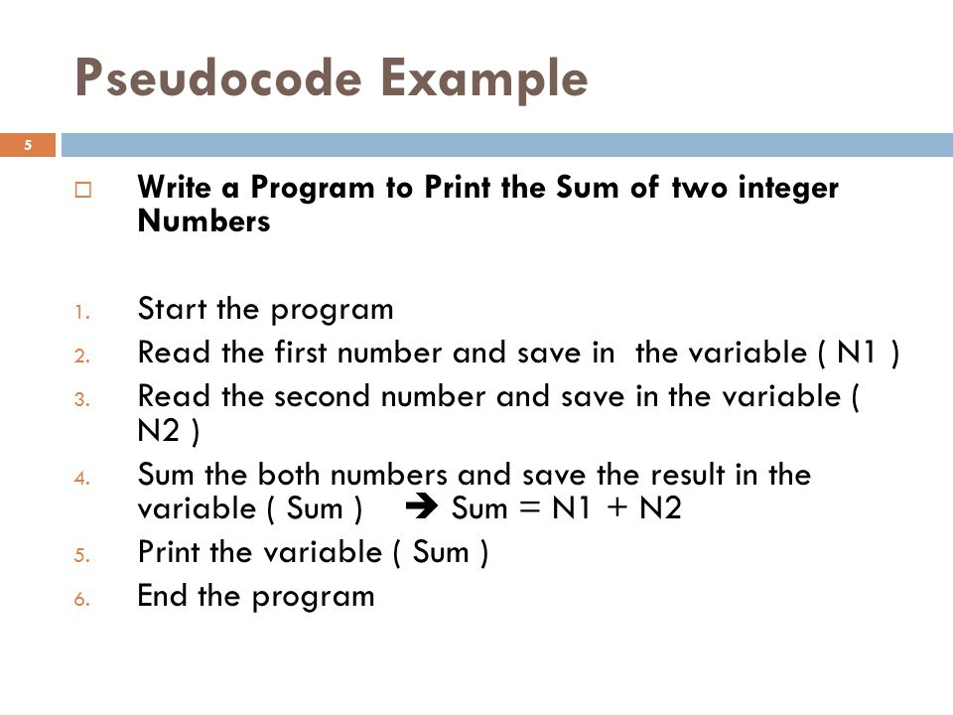

Slide 20
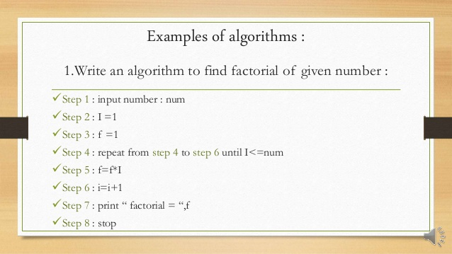

Slide 21
Advantages of the Algorithm
It identifies the solution process, decision points and variables required to solve the problem.
It helps in dividing a huge problem into smaller manageable steps of the solution.
The analysis and specification of the process lead to the efficiency.
Separation of the steps divides labour and development expertise.

Slide 22
Advantages of the Flow Chart
The flowchart is a good way of conveying the logic of the system.
Facilitates the analysis of the problem.
Provides a proper documentation.
Easy identification of the errors and bugs.
It directs the program development.
Maintenance of the program becomes easy.

Slide 23
Disadvantages of the Algorithm
At a specific point, the algorithm terminates.
Inability to solve problems that generate non-computational results.
Consumes a lot of time.

Slide 24
Disadvantages of the Flow Chart
The complex logic could result in the complex flow chart.
A flowchart must be recreated to employ modification and alterations.

Slide 25
Thank You
Very thanks to.. https://techdifferences.com

